Slide 1
Hello Elixir!
Sameeri Marryboyina

Slide 2




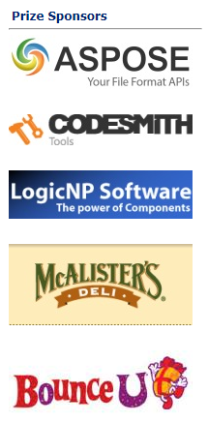


Thank you sponsors

Slide 3


OKC FP
OKC Elixir

Slide 4

Talk Agenda
Target Audience
About Me
Foundations
How I met Elixir?
Elixir

Slide 5
ABOUT ME

Slide 6
Hello, sameeri.
Sameeri Pavan Kumar Marryboyina
Hyderabad, India (MAP)
I can communicate in Telugu, Hindi, English, German(very little)
MS in Computer Science, The University of Oklahoma
Senior Software Engineer, Telogical Systems LLC
Full Stack JS - React, Redux and its Ecosystem, Node, Express
Norman, OK

Slide 7
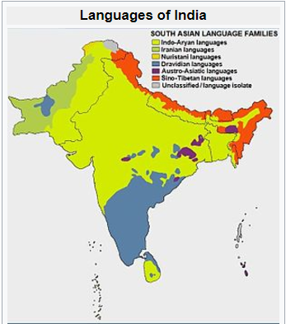
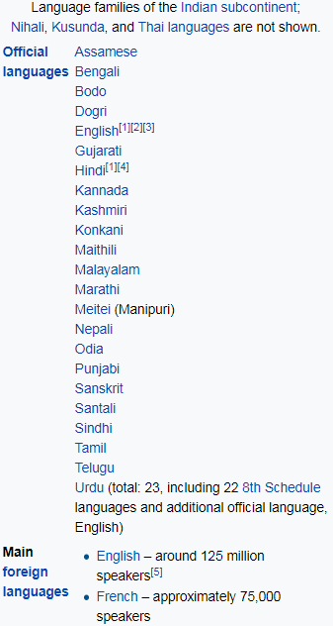
source : https://en.wikipedia.org/wiki/Languages_of_India

Slide 8
FOUNDATIONS

Slide 9
Being a polyglot...
WORK | SCHOOL | LEARNING | RADAR
JavaScript | C | Elixir | Elm
C# | C++/VC++ | Erlang | TypeScript
Ruby | COBOL |  | Python
Java | Assembly |  | Scala
 |  |  | Rust
 |  |  | Go

Slide 10

But, What does it mean to be a Language?

Slide 11
What kind of a problem are we trying to solve?
A language is a tool.
Problems and Contexts
We want to use the right tool for a given problem
Communication

Slide 12
A Language…
Alphabet
Constructs
Syntax
Semantics
Type System (Static vs Dynamic)
Translation Model (Compiled vs Interpreted)
Execution model
Runtime Mechanics
Specification
Implementation

Slide 13
Language tools
Editor
Compiler
REPL
Virtual Machine
Debugger
Standard Library
Dependency Management
Build tool
Workflow tools based on processes – Tests, Coverage, Syntax highlighting, Refactoring…

Slide 14
Inside the head of a software engineer
Language Syntax
Types
Philosophy
Paradigms
Standards/Best Practices
Principles
Patterns
Problem + Context
Crafting solutions

Slide 15
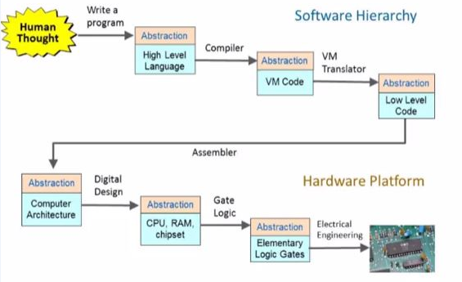
The process – From Human thought to something magical
source : http://www.nand2tetris.org/

Slide 16
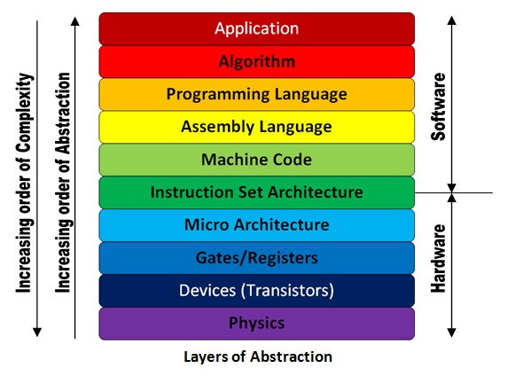
The Machine stack – Layers of Abstraction
source : http://theembeddedguy.com/2016/05/15/layers-of-abstraction/

Slide 17
Language translation
TRANSLATOR
SOURCE
LANGUAGE
TARGET LANGUAGE

Slide 18
Virtual Machine

